Slide 1
Version Control
Git & Github

Slide 2
History of version management
Source Code Control System (SCCS)
1972, Closed source, free with UNIX
Revision Control System (RCS)
1982 , Open Source, cross platform, faster, more features
Concurrent versions system (CVS)
1986-1990, open source, multiple files, multiple users
Apache Subversion (SVN)
2000, open source, support for directory tracking, support for non-text
BitKeeper SCM
2000, closed source, proprietary
distributed version control
“community version” was free initially ; from 2005 no longer free
used for source code of Linux kernel from 2002 – 2005
GIT
Born April 2005, created by Linus Torvalds
Replacement for BitKeeper to manage Linux kernel

Slide 3
Distributed Version Control
Different users maintain their own repositories instead of working from a central repository
Changes are stored as “Change sets” or “patches”
Tracks changes not versions
Change sets can be exchanged between repositories
Example , suppose a file has following sets of changes – A,B,C,D,E,F
Different repositories may have different combinations of the above change sets
Repo 2
A,B,C,D
Repo 1
A,B,C
Repo 3
A,B,C,D,E,F

Slide 4
Why GIT
Distributed version control system
No need to communicate with a single server
Faster
No network access required
No single failure point
Encourages collaborative development (“forking”)
Open Source and free
Compatible with UNIX like systems and Windows
Faster than other SCMs

Slide 5
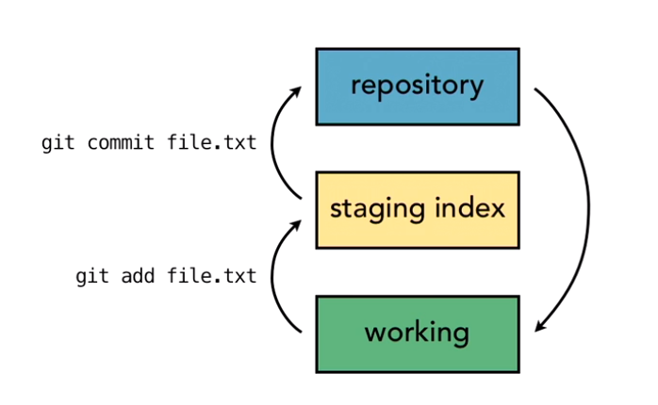
GIT Architecture of 3 trees

Slide 6
Activity 1
Install git on your system
Verify installation: check version using command prompt

Slide 7
GIT Buzzwords
Master:
It is a default branch.
It is used by CI tools for build and deployment.
It is followed by the other repositories.
Branch:
It is a light weight working copy.
It has a staging area.
It works without impacting the master branch.

Slide 8
Head:
It is a pointer to the latest commit of the working branch.
It is present on every repository.
It will point to the latest commit during branch switch.
Remote Repo:
It is a git repository on a network outside the local machine.
It can have more than one remote repositories pointing from the local repository.
It can be managed and referenced with short names.
Push:
It pushes changes from the local to the remote repository.
It is performed after committing the changes to the local repository.
It syncs the changes with the local and remote repository.

Slide 9
Pull:
It transfers the updates from the local to the remote repository.
It syncs the changes from remote to the local repository.
It takes current code from remote repository and merges the change with the local repository.
Fetch:
It will not merge the changes with a local repository.
It gives updates from remote to the local repository.
It syncs the changes from remote to the local repository.

Slide 10
Origin:
It associates remote repository with names.
It is a local name set for the default repository.
It is useful to point the default repository when executing git commands.
Clone:
It copies the existing repository from a remote repository.
It will get the complete repo, whereas checkout will only fetch the working copy.
It helps to replicate the repo on the local machine.

Slide 11


Local repository
Remote repository
Upstream
Downstream
When the data is flowing between repository A and B, repository A is upstream and B is downstream making B pull data from repository A.

Slide 12
Git VS Github
Git
It is installed and maintained on the local system.
It is a command line tool.
It is a tool to manage different versions of the file in a git repository.
GitHub
It is hosted on the web.
It is a graphical interface.
It is a space to upload a copy of the git repository.

Slide 13
GIT Configuration
3 types
System Level
Global Level
Local level

Slide 14
System Level Configuration
Affects all users and all repositories on the system
Stored in the $(prefix)/etc/gitconfig file.
System level username
git config --system user.name "System User"
System level email
sudo git config --system user.email "systemuser@example.com"
System-Level Default Editor:
git config --system core.editor "notepad"
Enable System-Level Colored Output:
git config --system color.ui auto
Viewing System-Level Configurations:
git config --system --list

Slide 15
Global Level Configuration
Global level configurations in Git are user-specific settings that apply to all repositories for the current user.
These settings are stored in the ~/.gitconfig file (usually found at C:\Users\<YourUsername>\.gitconfig on Windows).

Slide 16
Set Global Username:
git config --global user.name "Your Name"
Set global Email:
git config --global user.email "you@example.com"
Set global default editor
git config --global core.editor "notepad"
Set global coloured output
git config --global color.ui auto
Set global aliases:
git config --global alias.co checkout
git config --global alias.br branch
git config --global alias.ci commit
git config --global alias.st status
View all configuration:
git config --global --list

Slide 17
Local Configurations
Assume you want to set a specific username and email for a particular repository, different from your global settings, and create a few local aliases.
Local user or email
git config --local user.name "Your Local Name"
git config --local user.email "local@example.com"

Slide 18
Git Commands
Initializing a new repository
Create a new repository on local: git init
Browse files added by GIT
Adding new files
Check git status: git status
Add file to staging area: git add filename
Commit to Repo: git commit
View log: git log
Unstage: git reset

Slide 19
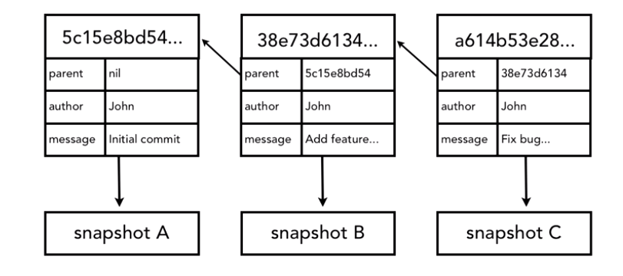
How GIT manages and stores commits?
Every change set that is committed is converted to a checksum using SHA-1 hash algorithm
SHA id is 40 character hexadecimal string

Slide 20
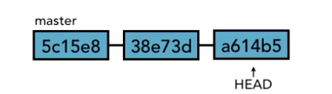
HEAD Pointer points to the tip of the current branch on repository

Slide 21
Editing / Deleting / Renaming / Undoing changes
Editing files
Viewing git status: git status
Committing changes directly to repo: git commit -a
Viewing diff between repo and working: git diff
Viewing diff between repo and staging: git diff --staged

Slide 22
Let’s take one scenario
You have modified a file named hello.txt in your working directory.
You have staged some changes in sonam.txt.
You want to see what changes are unstaged, what changes are staged, and what changes were made in the last commit.
Show Unstaged Changes: git diff
Show Staged Changes: git diff –staged
Show Changes in the Last Commit: git diff HEAD^ HEAD

Slide 23
Delete and Rename
Delete file :git rm <filename>
Rename: git mv <old-filename> <new-filename>

Slide 24
Undo Changes
Undoing changes to modified files:
git checkout -- <filename>
Undoing changes to staged files:
git reset HEAD <filename>
Undoing a commit: If you have already committed changes and want to undo the last commit (while keeping the changes in your working directory): git reset --soft HEAD^
This will undo the last commit but leave your changes staged.
Completely discarding all local changes:
git reset --hard HEAD

Slide 25
Revert
If you have already pushed changes to a remote repository and want to revert a commit, you can use:
git revert <commit-hash>
This will create a new commit that undoes the changes introduced by the specified commit.

Slide 26
Show Commit History
Git log: show all commits
To exit from many commit you can press q
git log -n 5: This will show the last 5 commits in your repository's history.
Search within git log:
git log --grep="search-term"
Git log in one line: git log –oneline
Git show: showing details of commit

Slide 27
Branching
Create branch: git branch
Switch branch: git branch <name>
Show all branches: git checkout –b <branch>
View HEAD pointers of all branches: git diff master..branch
Compare tips of two branches
Delete branch

Slide 28
Example
Create a new branch named 'feature/new-feature' and switch to it
git checkout -b feature/new-feature
Make changes to your code and commit them on the 'feature/new-feature' branch
git add .
git commit -m "Added new feature"
Switch back to the main branch
git checkout main
Compare tips of two branches (main and feature/new-feature)
git diff main..feature/new-feature
View all branches (local and remote)
git branch -a
View HEAD pointers of all branches
git show-ref
Merge 'feature/new-feature' branch into 'main' (assuming no conflicts)
git merge feature/new-feature
Delete the 'feature/new-feature' branch after merge
git branch -d feature/new-feature

Slide 29
True Merge
Assume you have diverged branches: main and feature/branch-b.
Create a new branch and make changes:
git checkout -b feature/branch-b
Make changes to files and commit them
git add .
git commit -m "Made changes in feature branch“
Switch back to main and merge:
git checkout main
git merge feature/branch-b
If there are new commits on both main and feature/branch-b, Git performs a true merge, creating a new commit that combines changes from both branches.

Slide 30
Aborting a Merge:
Start the merge:
git merge feature/branch-b
Here, you have encounter some conflicts and decide to abort for other reasons.
git merge --abort

Slide 31
Resolving Conflict Manually:
Create and switch to a new branch (feature/branch-c):
git checkout -b feature/branch-c
Make changes to file.txt and commit them
echo "Feature branch content" > file.txt
git add file.txt
git commit -m "Made changes in feature branch"
Switch back to main and make conflicting changes:
git checkout main
Make conflicting changes to file.txt and commit them
echo "Main branch content" > file.txt
git add file.txt
git commit -m "Made changes in main branch"

Slide 32
Merge feature/branch-c into main, causing conflicts:
git merge feature/branch-c
Git will detect that file.txt has conflicting changes in both branches and will output a message indicating a merge conflict.
Decide which changes to keep or modify file.txt accordingly.
Feature branch content and Main branch content combined (modify it manually)
Stage the resolved file and commit the merge:
git add file.txt
git commit

Slide 33
Tagging
tags are used to mark specific points in the repository's history, such as releases or significant commits.
There are two types of tags:
lightweight tags
annotated tags.

Slide 34
Lightweight Tags
A lightweight tag is simply a pointer to a specific commit. It's similar to a branch that doesn't change — it's just a reference to a commit.
git tag <tag-name>
E.g. git tag v1.0.0

Slide 35
Annotated Tags:
An annotated tag, on the other hand, is stored as a full object in the Git database.
It includes a tagger name, email, date, and a tagging message.
Annotated tags are recommended for most use cases as they provide more information and context about the tag.
git tag -a <tag-name> -m "Tagging message"
E.g. git tag -a v1.0.0 -m "Initial release version 1.0.0"

Slide 36
Viewing Tags:
To view all tags in the repository:
Git tag
View details of specific tag:
git show <tag-name>

Slide 37
Pushing Tags:
Tags created locally are not automatically pushed to remote repositories.
To push tags to a remote repository:
git push origin <tag-name>
To push all tags to the remote repository:
git push origin --tags

Slide 38
Deleting Tags:
To delete a tag locally:
git tag -d <tag-name>
To delete a tag from the remote repository (after it has been pushed):
git push origin --delete <tag-name>

Slide 39
Remotes – Create repository on Github
Create a new repository on Github
Copy the URL of the new repository
Clone the repository on your laptop.
Create two repositories on local
git clone <URL> GITLab1
git clone <URL> GITLab2

Slide 40
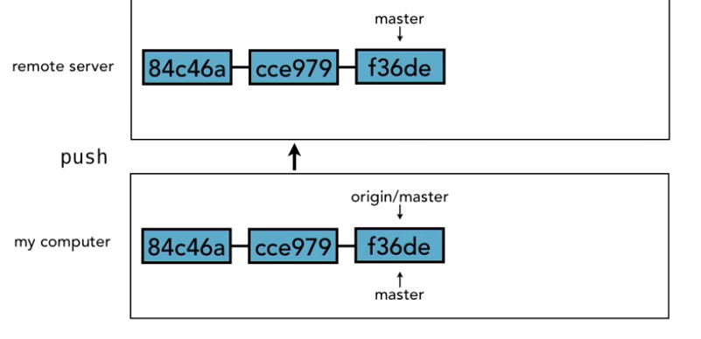
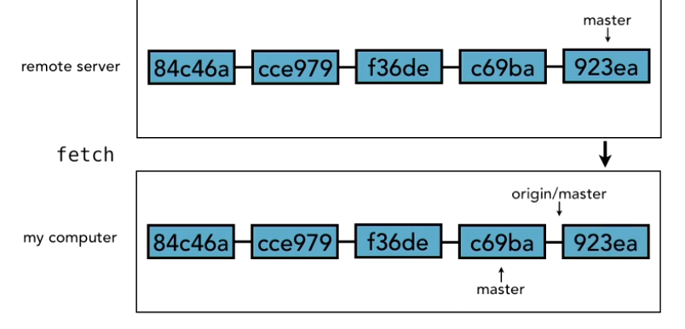
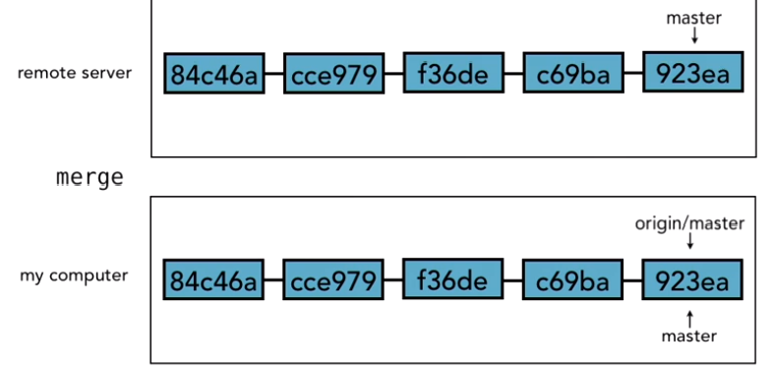
Working with remotes

Slide 41
Tracking and non tracking branch
Push –u always creates a tracking branch that tells GIT about the remote details.
Without –u, push will send changes to remote without creating a tracking branch to sync changes
Clone automatically creates a tracking branch

Slide 42
Pushing / Fetching changes to/from Remote
Pushing changes to remote: git push
Viewing tracking branch: git branch -vv
Viewing changes on Remote:
git fetch origin (Fetches the latest changes from the remote repository)
git branch –r (view remote branch)
Push a new local branch to remote:
git checkout -b new-branch-name (Creates a new branch named new-branch-name and switches to it.)
git push -u origin <local-branch-name>

Slide 43
Activity: Git Branching and Merging
Create a new branch (feature/username-task) from main.
Make changes to a file (README.md).
Commit changes to the feature branch.
Switch back to main and make different changes to the same file.
Merge the feature branch into main, resolving any conflicts if they occur.

Slide 44
Activity: Explore Git history and understand commit operations.
clone a small repository with a history of commits.
Use git log and git show commands to
View the commit history (git log).
Examine details of a specific commit (git show <commit-hash>).
Discuss the concept of commit hashes and how Git tracks changes over time.

Slide 45
Activity: Git collaboration and pull
Divide students into pairs or small groups.Assign roles (Developer A and Developer B).
Developer A creates a new feature branch (feature/xyz) and makes changes.
Push the feature branch to a remote repository (git push origin feature/xyz).
Developer B reviews the changes and suggests improvements.
Developer A integrates feedback, resolves conflicts if any, and merges the branch via a pull request.

